Slide 1
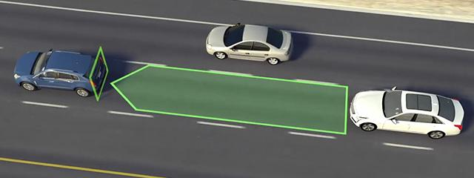
Adaptive Cruise Control
By: Tomas Colorado, Olivia Ferda, Jiasen Zhou

Slide 2
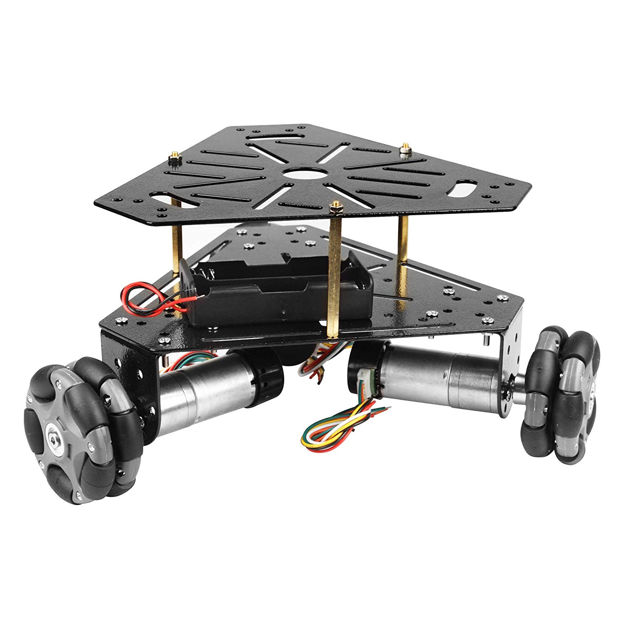
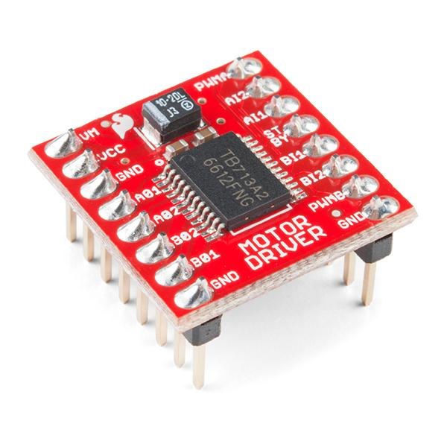
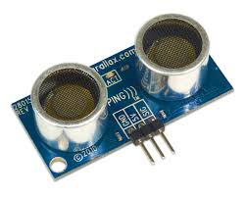
Design Overview
3 components:
Ultrasonic Sensor
Motor Driver
Robot Chassis Set
9V motor
Omni wheels
Triangular frame

Slide 3
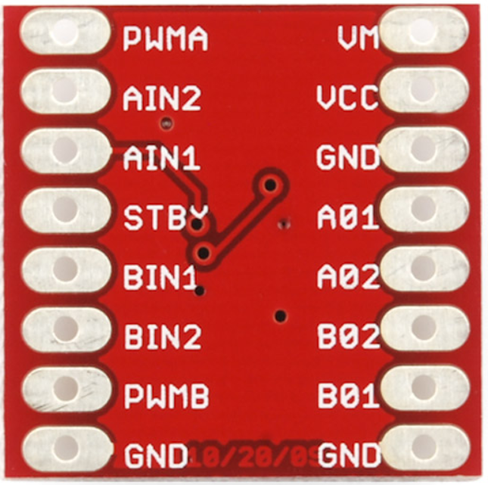
PWMA/B: PWM inputs that control the speed
Vm:power
VCC: the voltage to power the chip and communicate with Atmel board
GND: ground
STBY: Switch that enables the H-bridge work when is high
AIN/BIN: pins that determine the orientation of the motor
A01/A02/B01/B02: output to the motor

Slide 4
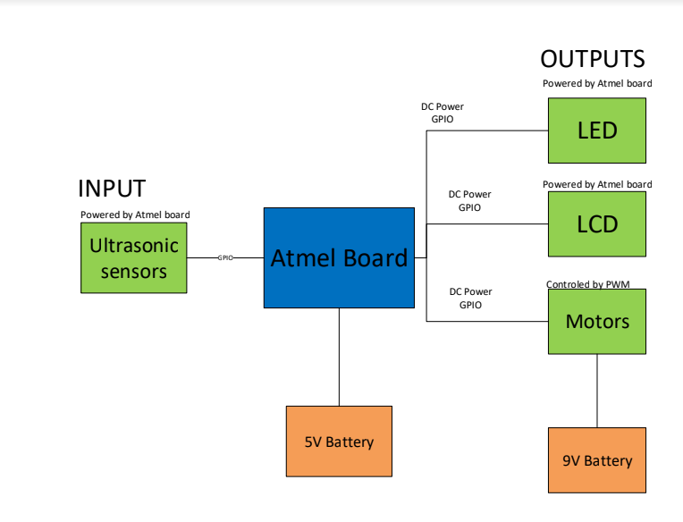

Slide 5
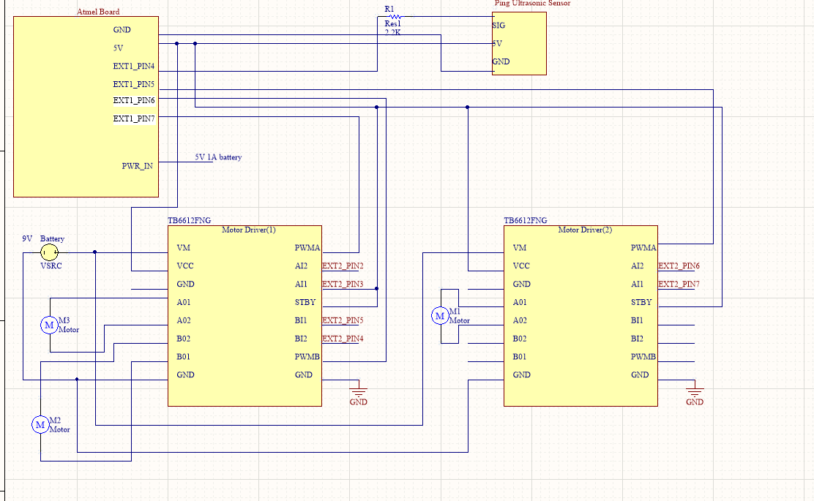
Hardware Design (Block Diagram and Schematic)

Slide 6
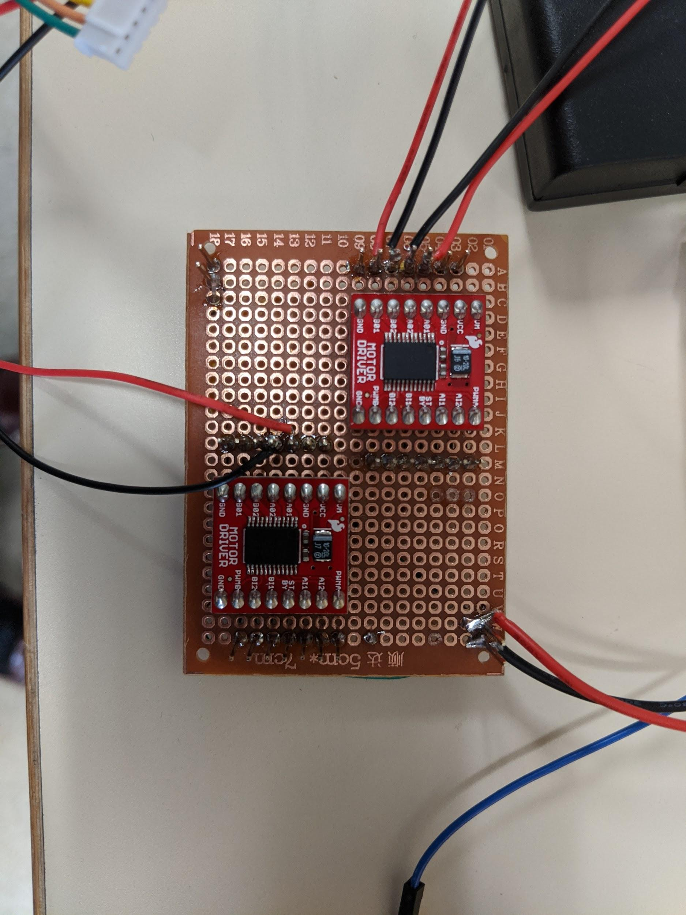
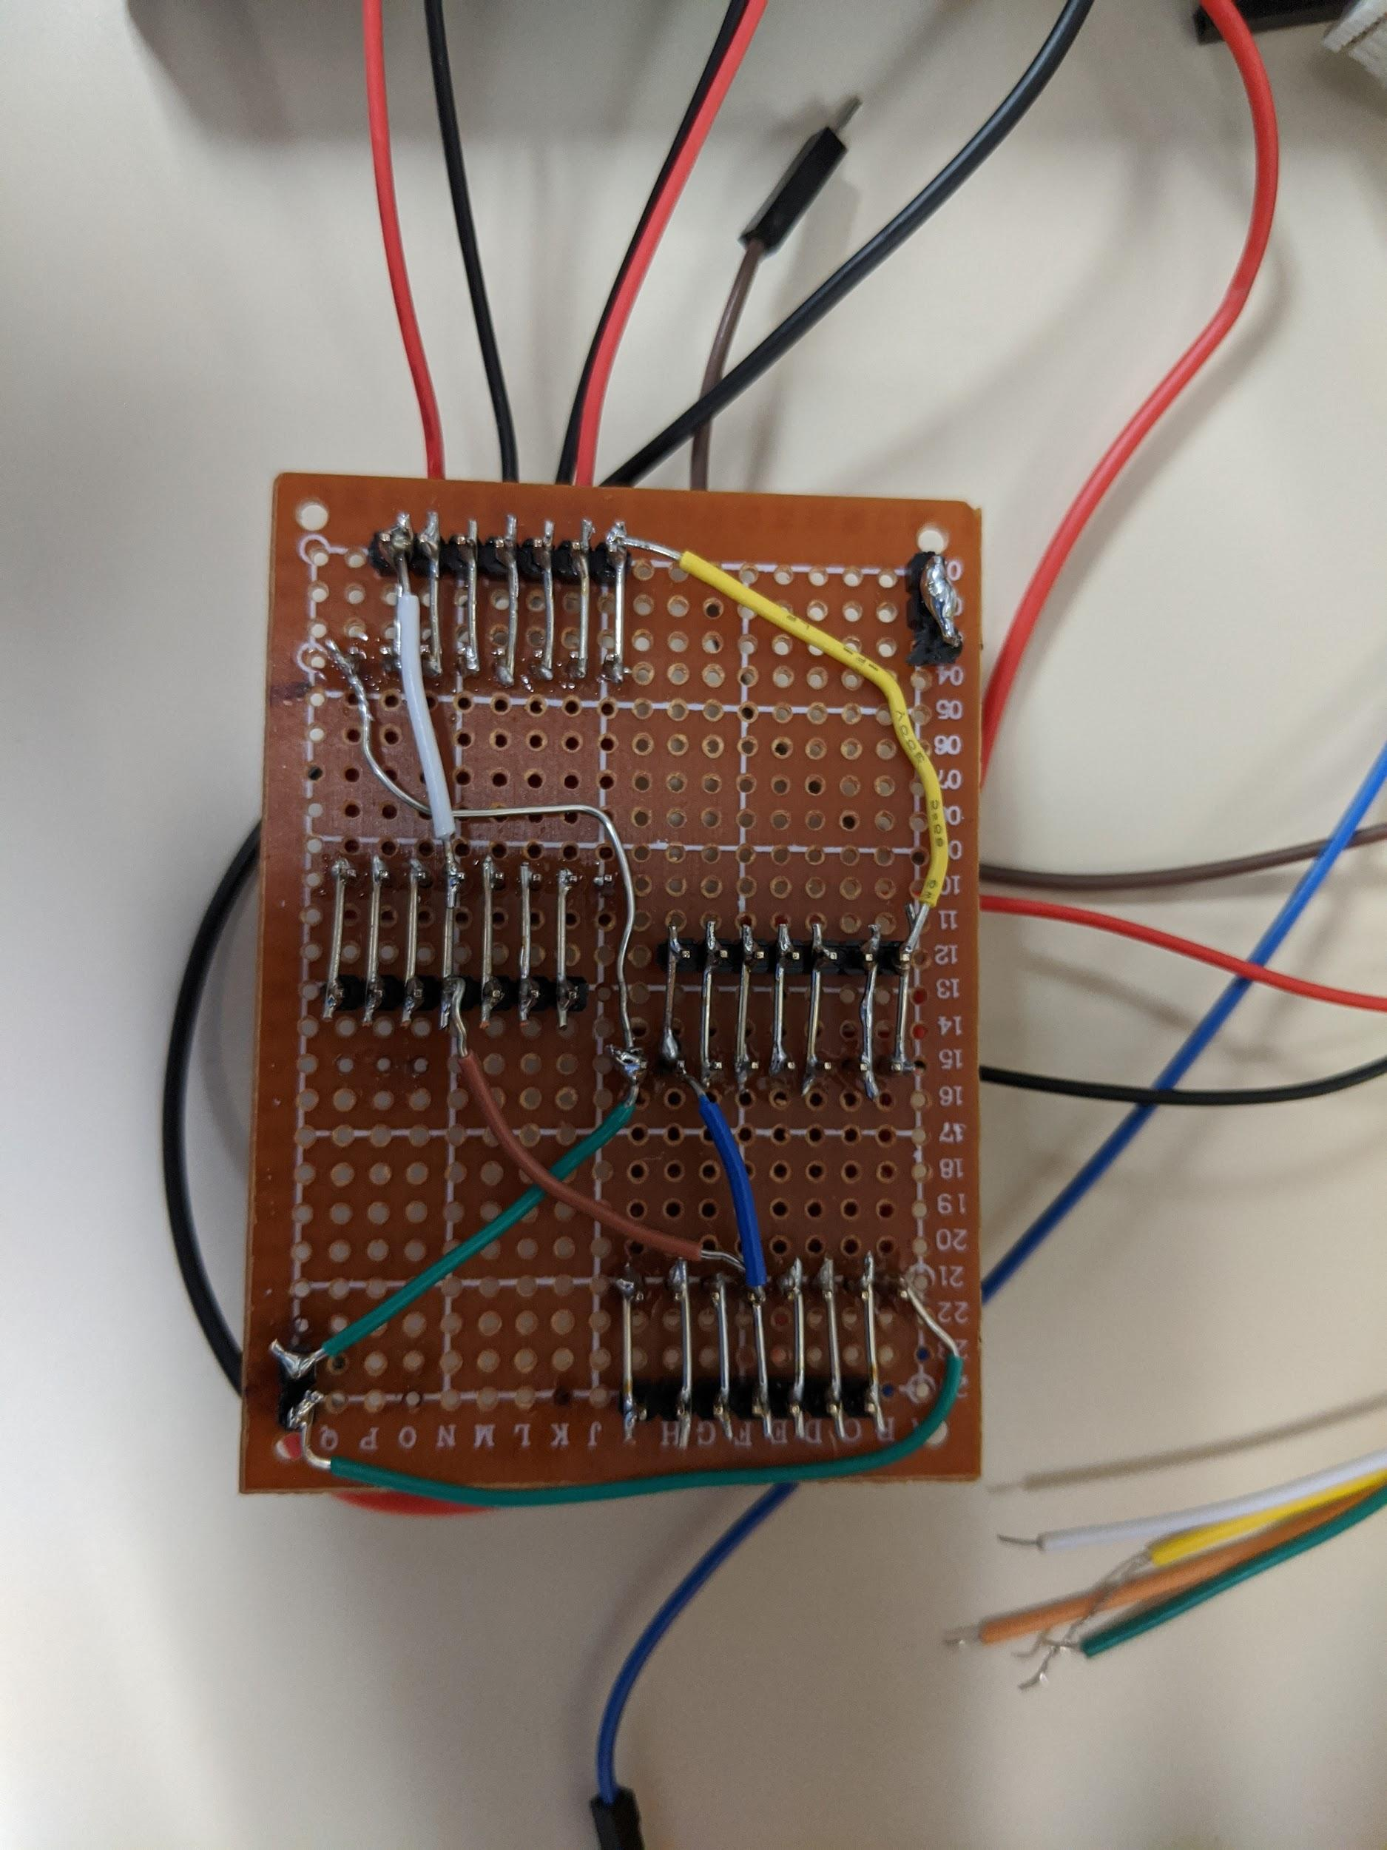
Hardware Implementation

Slide 7
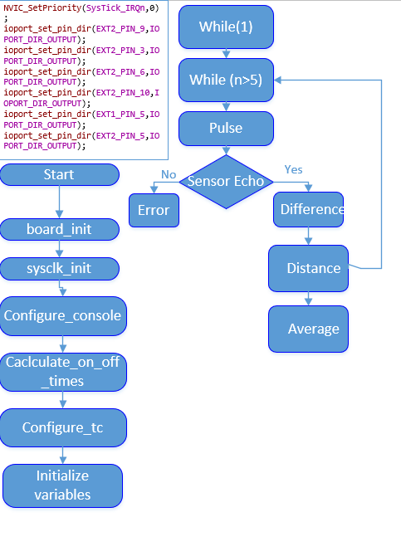
Code Activity Diagram: Sensor

Slide 8
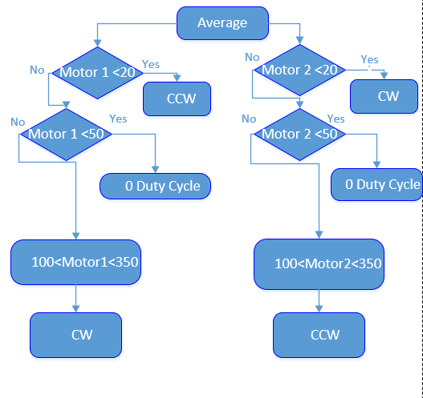
Code Activity Diagram: Motors

Slide 9
Code
Main.c
Utility.h
pwm function
Using TC to achieve the ability of PWM
Calculate_on_off_time based on duty_cycle
Turn on and off the pin in each period -- control speed

Slide 10
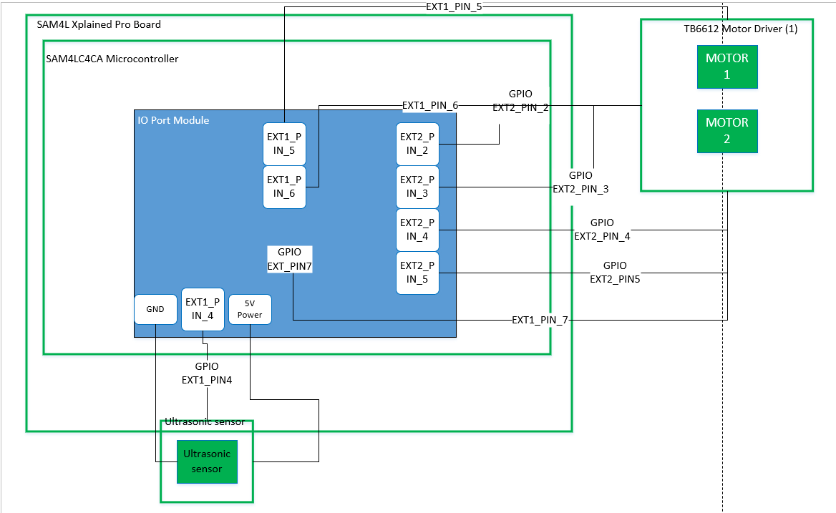
Functional Architecture

Slide 11
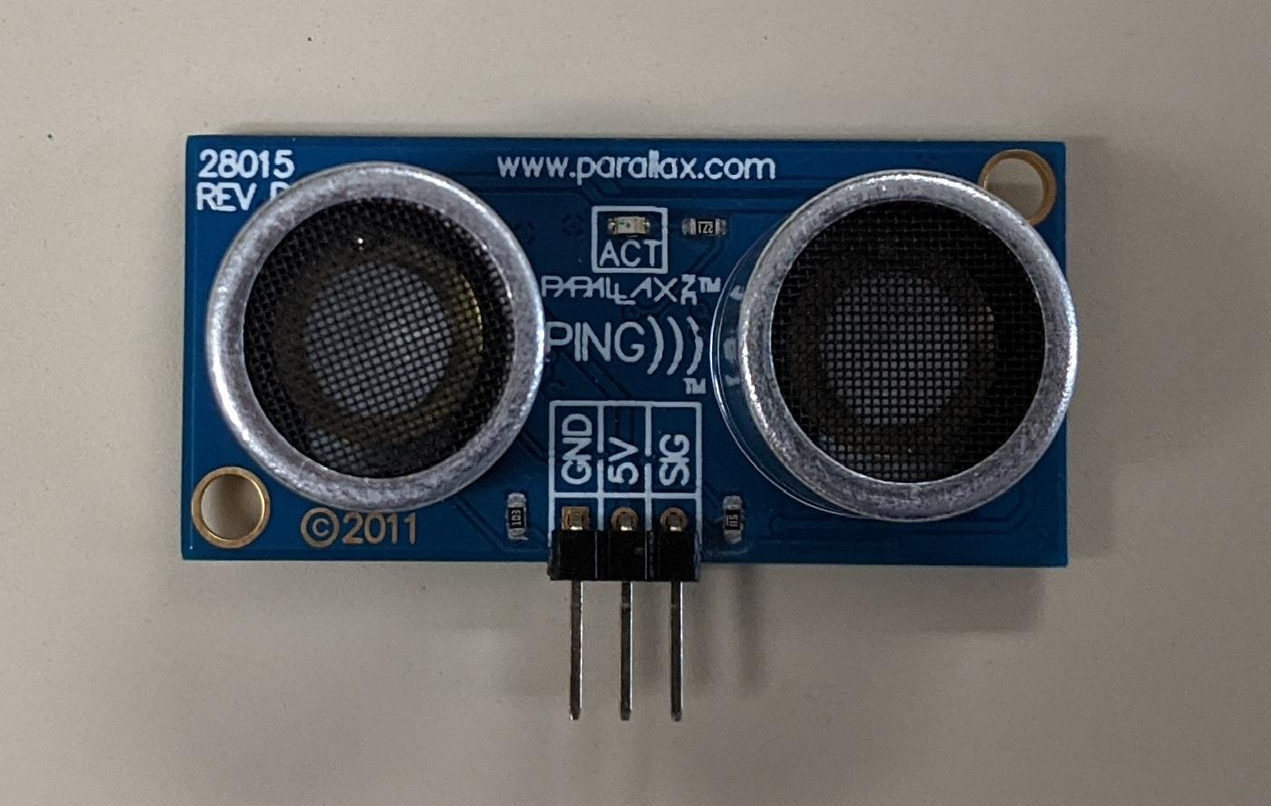
Failures and Lessons Learned
WASTED
Be careful with voltage dividers!
Read the datasheet!

Slide 12
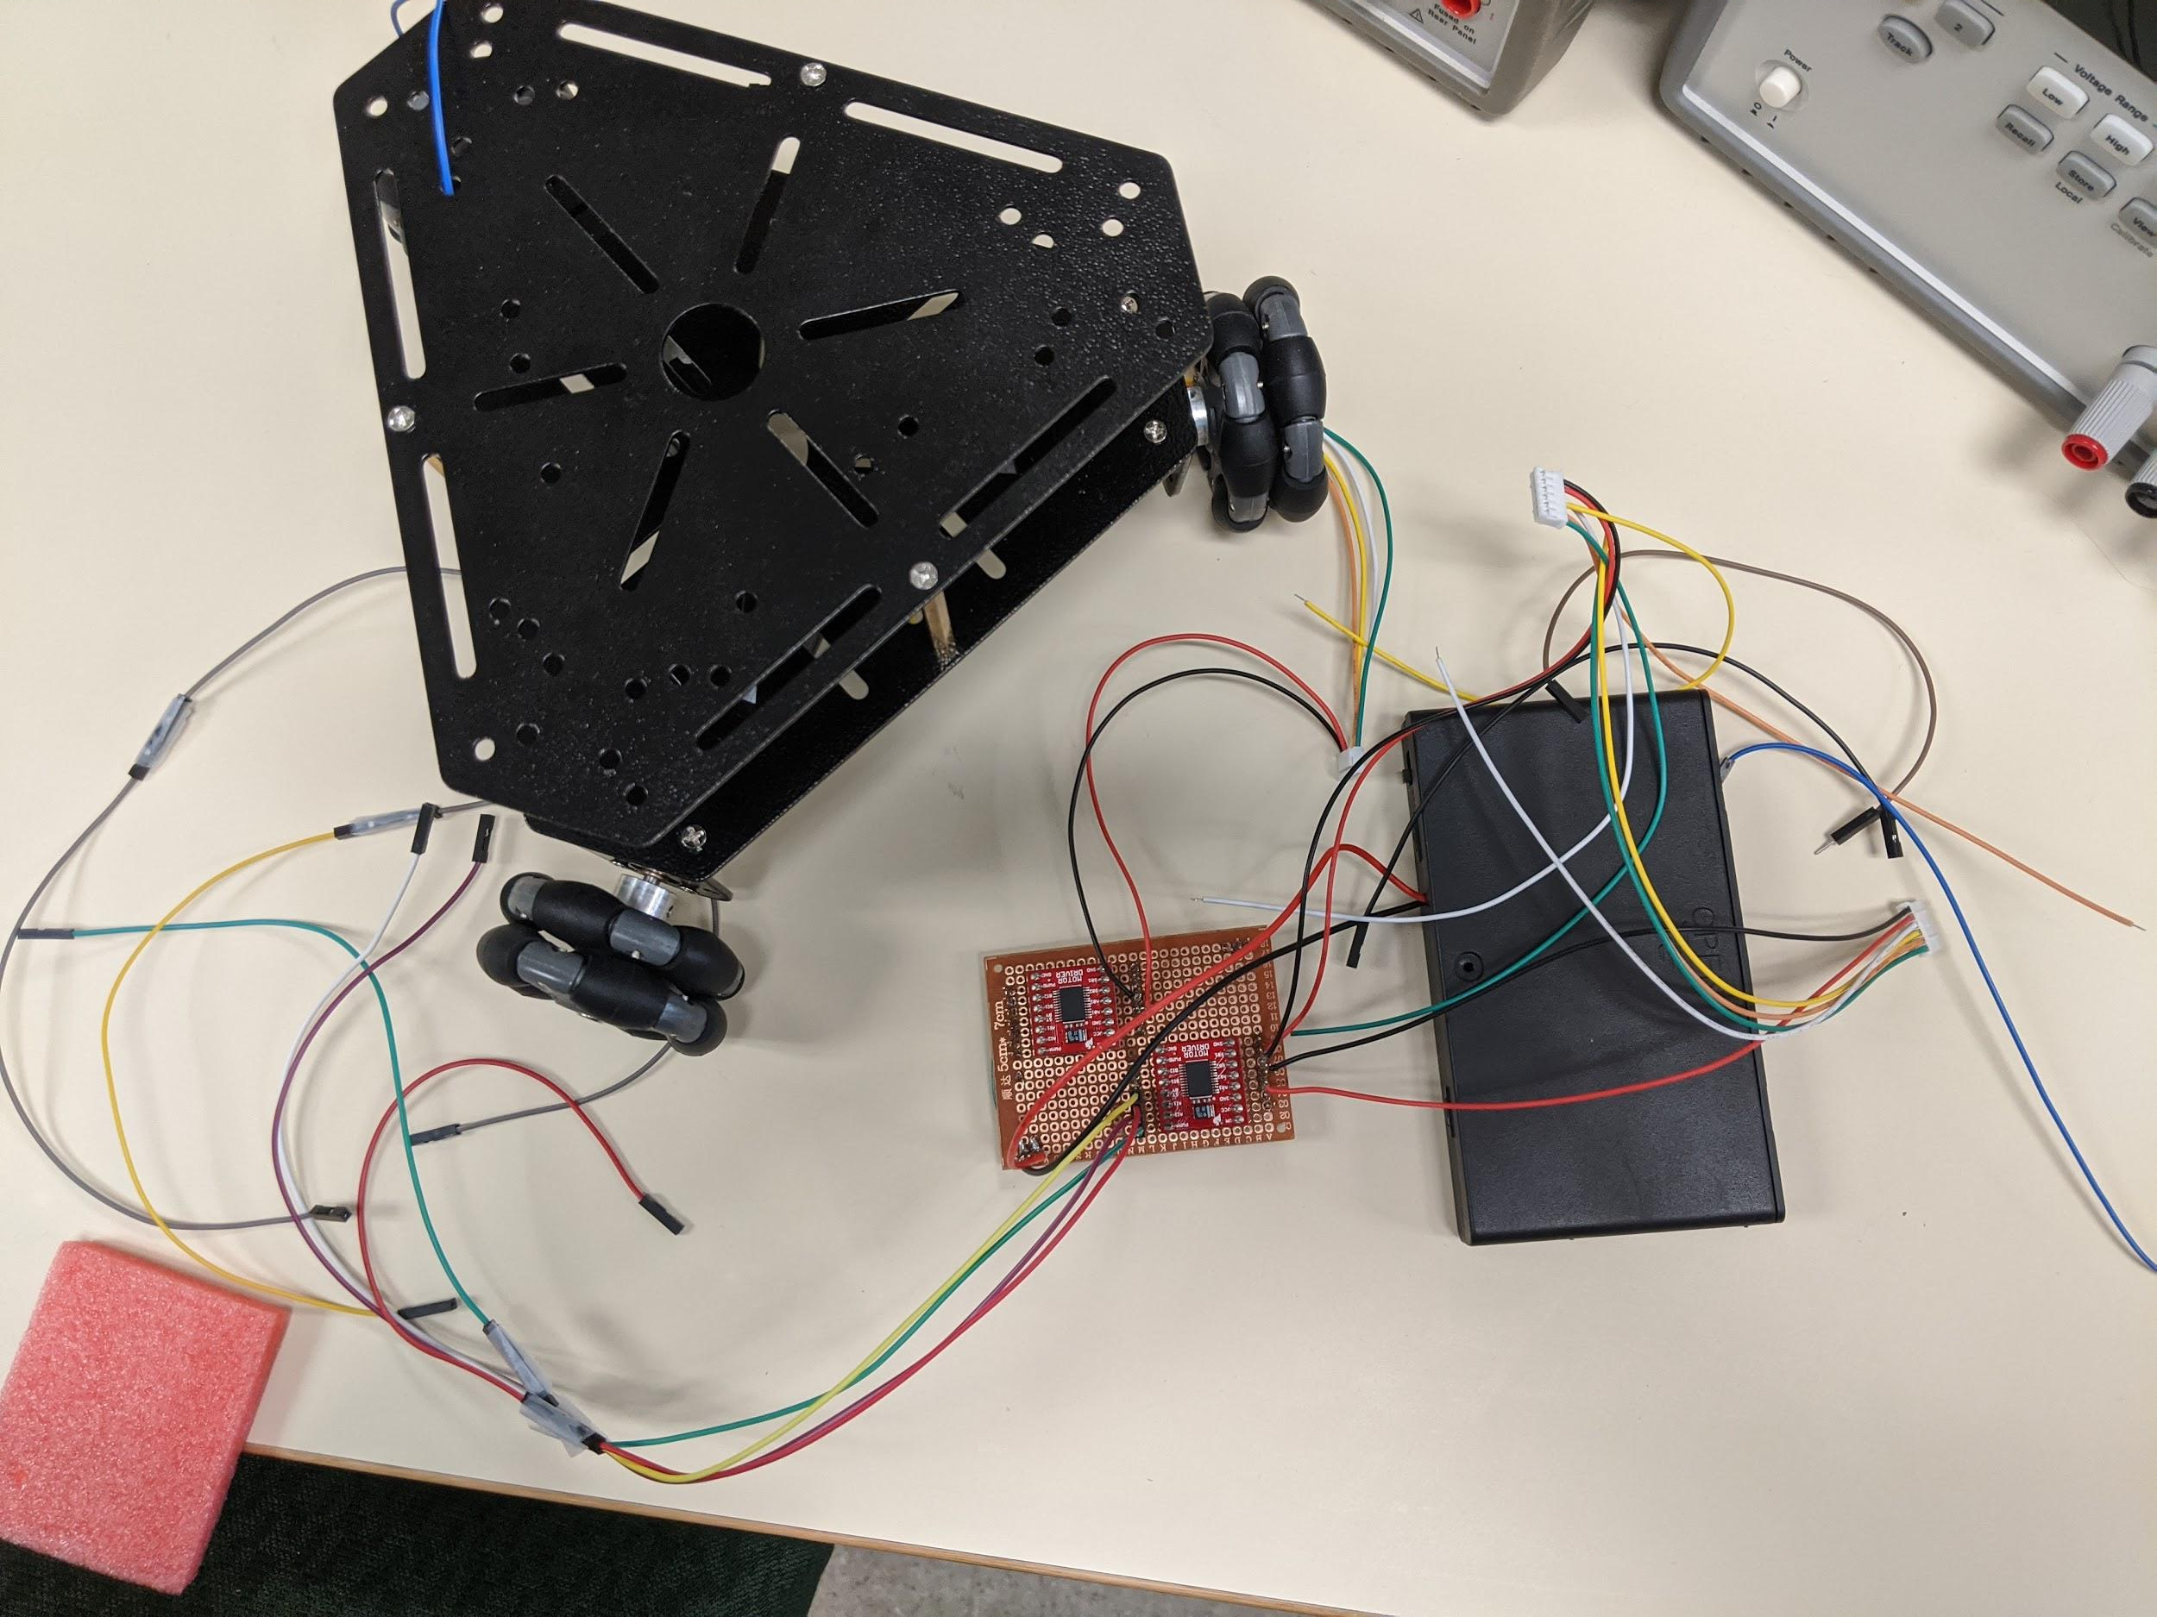
Future Improvements
Detail in Planning
Deadlines
Specifics for project
Cable Management
“Squid”

Slide 13
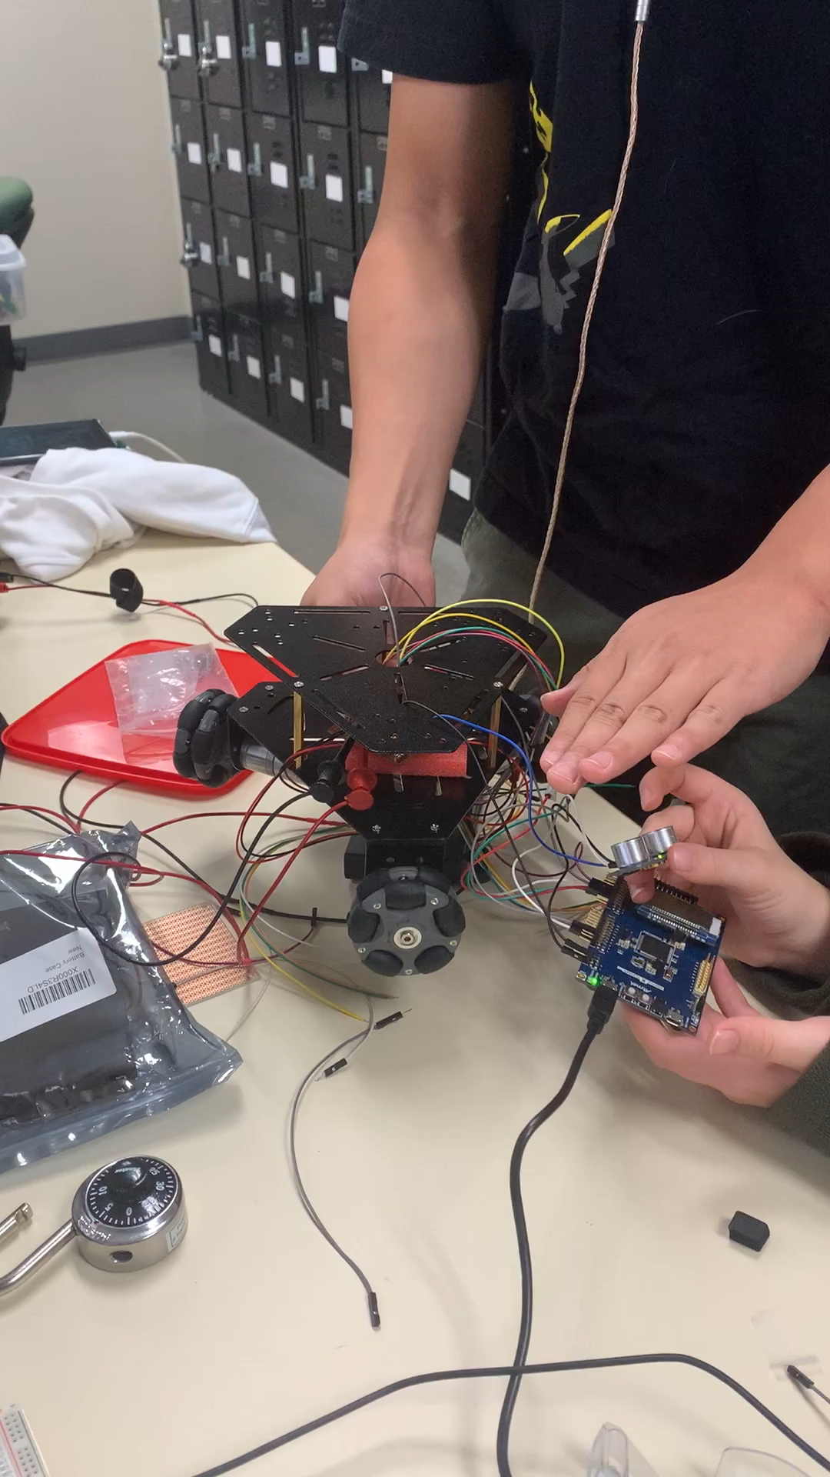

Slide 14
Questions?

